Slide 1
PHOENIXVILLE EARLY LEARNING CENTER
AND ELEMENTARY SCHOOL
phoenixville, pennsylvania
NOLAN JAMES AMOS
Dr. William Bahnfleth, Faculty Consultant
architectural engineering senior thesis
mechanical option

Slide 2
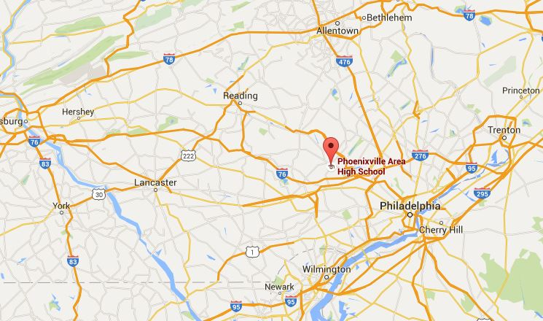
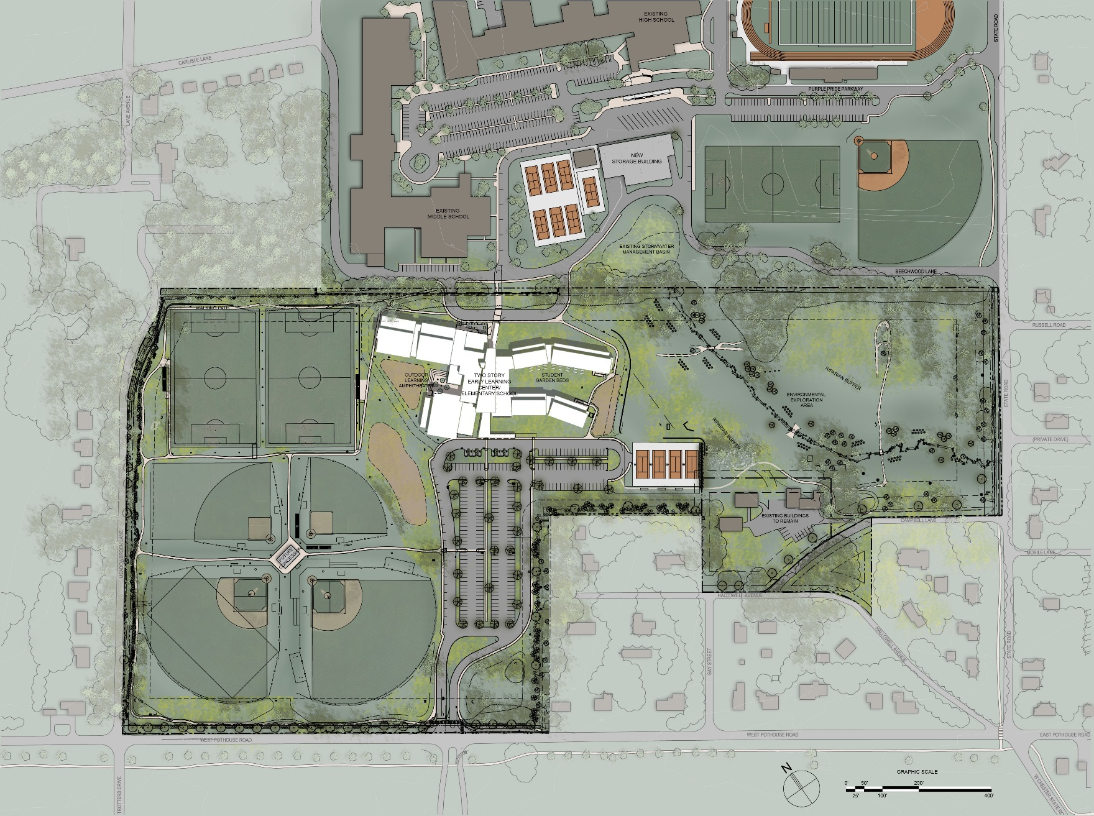
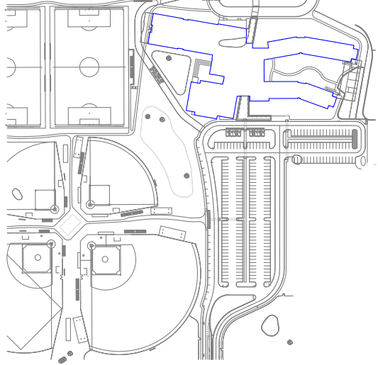

PHOENIXVILLE EARLY LEARNING CENTER
AND ELEMENTARY SCHOOL
site conditions
Rendering property of SHRADERgroup Architecture
overview
NOLAN JAMES AMOS |ae senior thesis

Slide 3
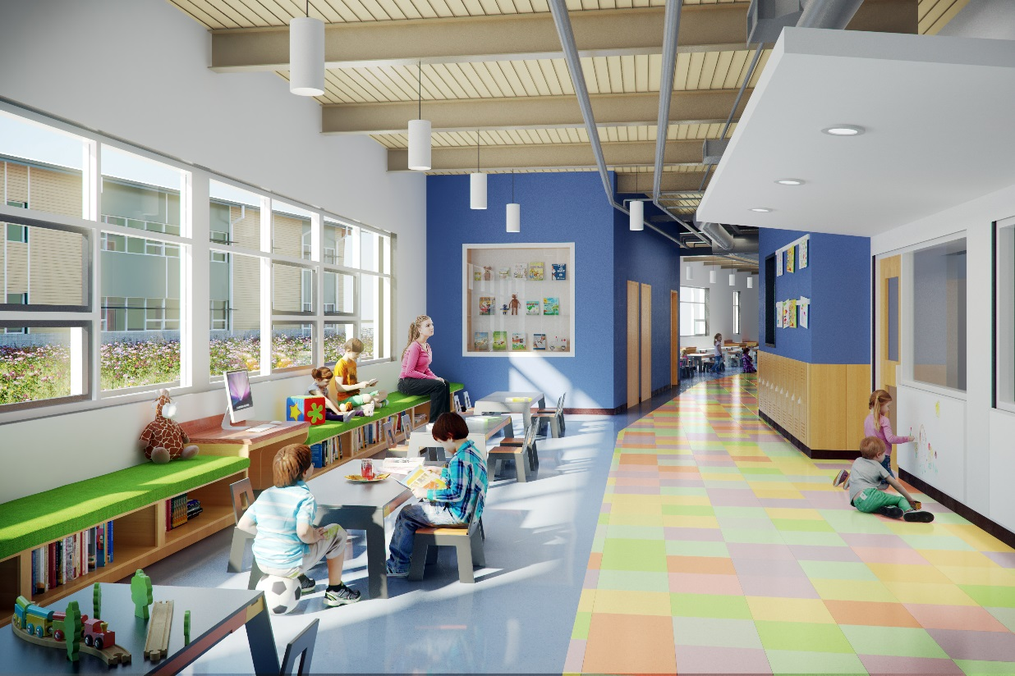
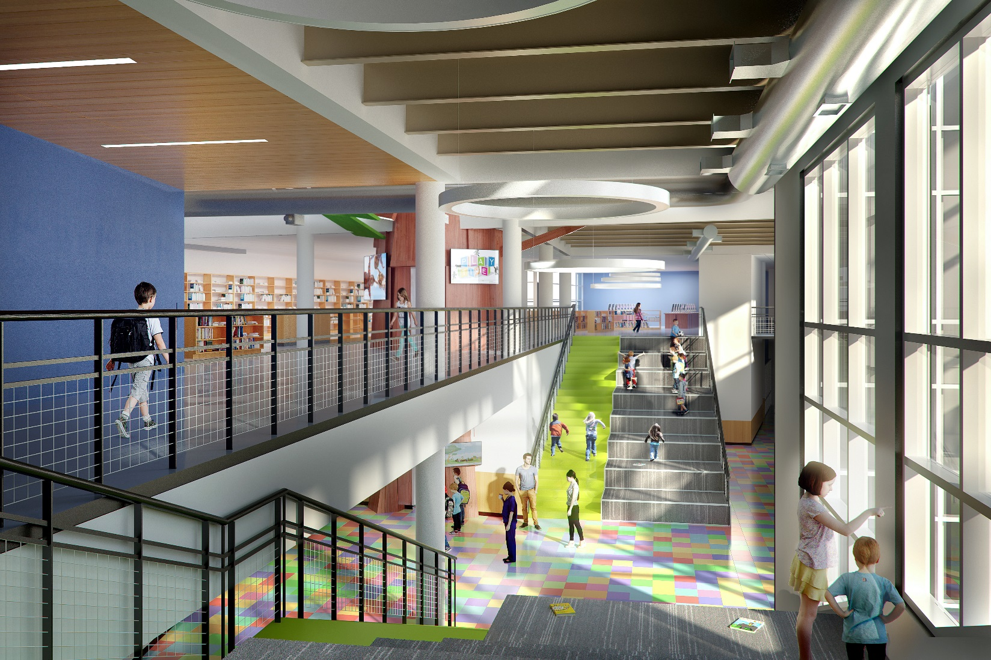
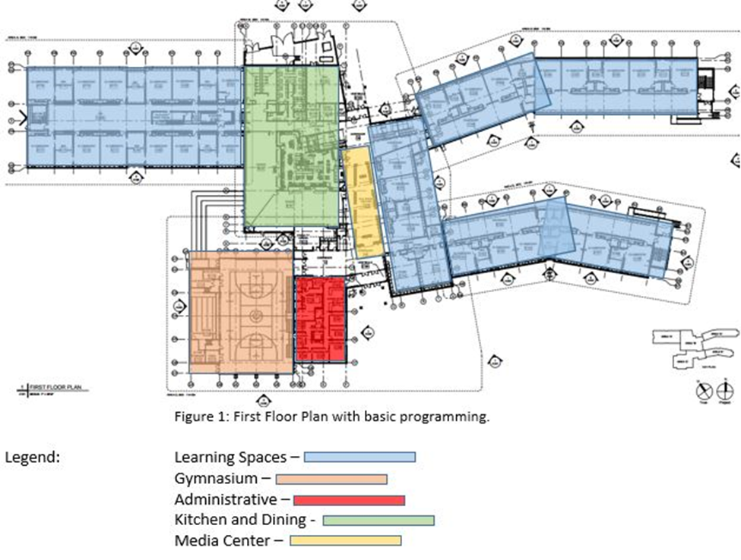
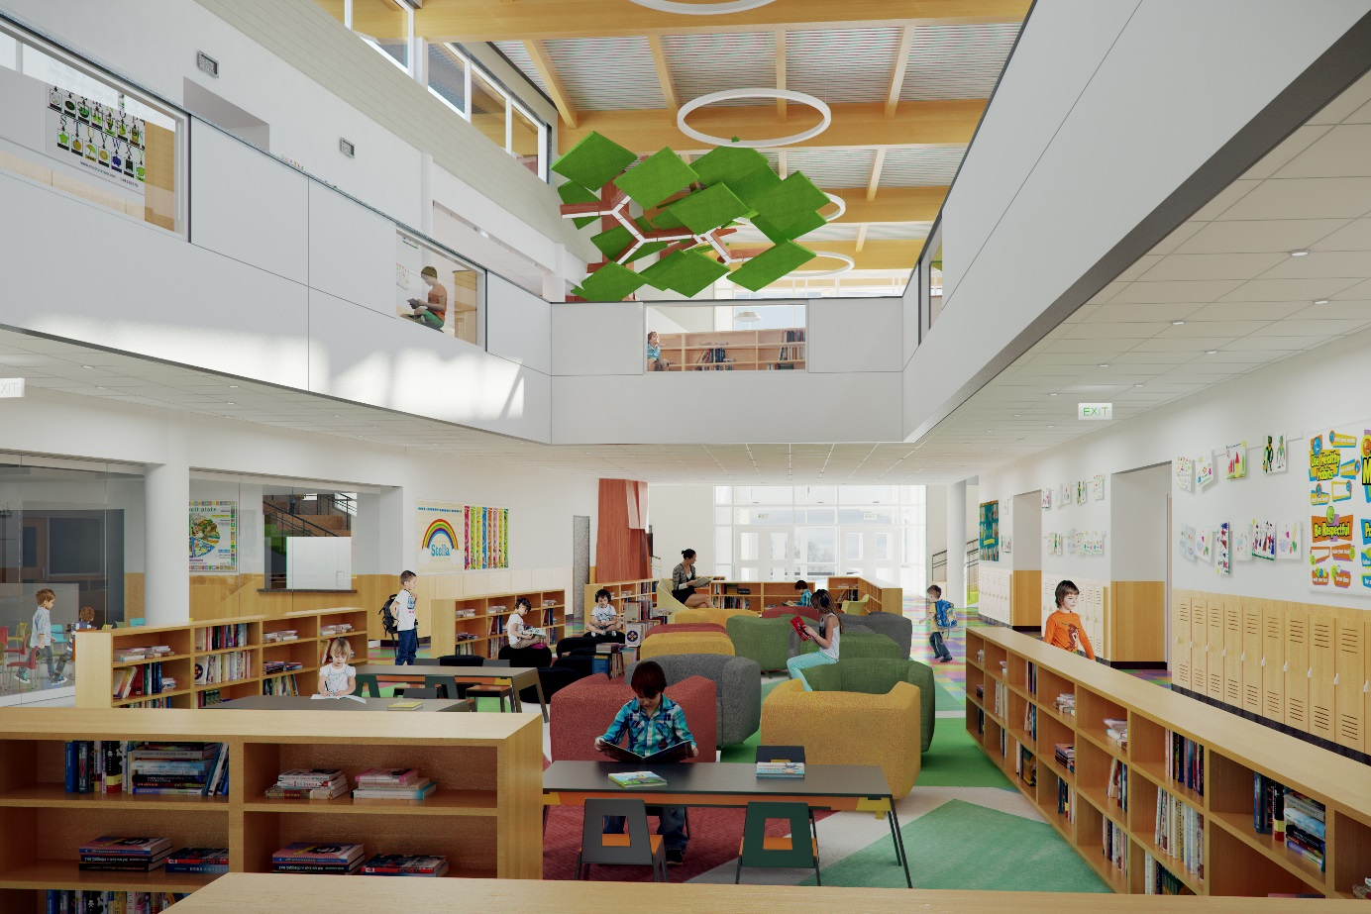
PHOENIXVILLE EARLY LEARNING CENTER
AND ELEMENTARY SCHOOL
architectural features
2 Stories – 41’-10”
Area: 152,000 SQ. FT.
Occupancy: 1526
Grades: K-5
Rendering property of SHRADERgroup Architecture
Rendering property of SHRADERgroup Architecture
Rendering property of SHRADERgroup Architecture
overview
NOLAN JAMES AMOS |ae senior thesis

Slide 4
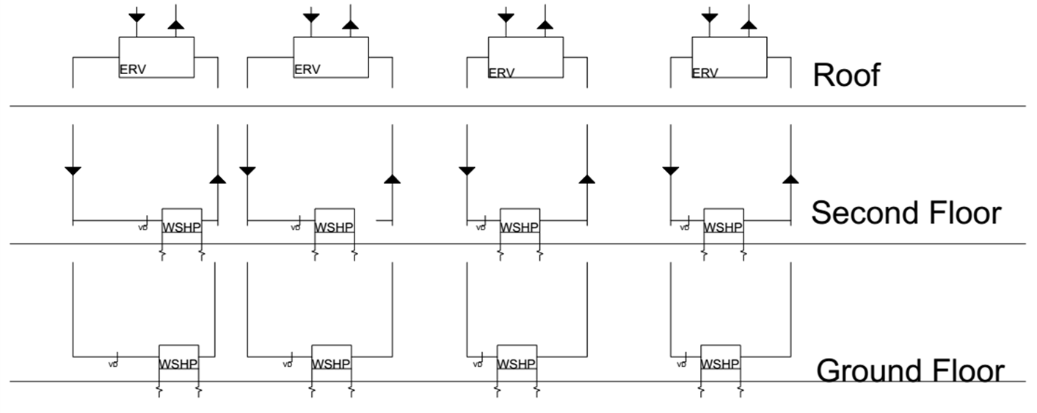
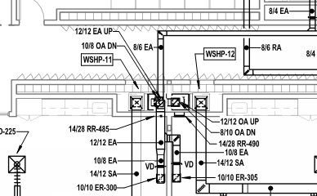
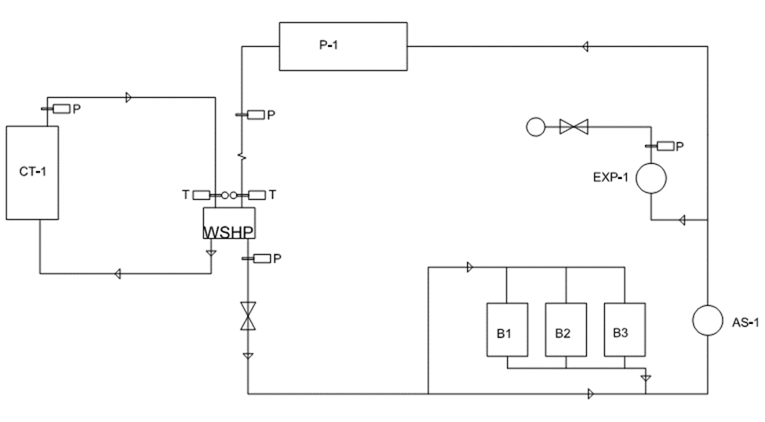
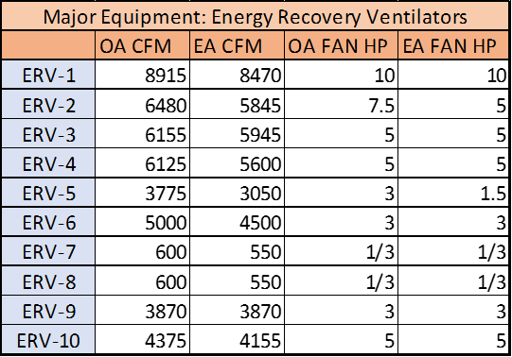
PHOENIXVILLE EARLY LEARNING CENTER
AND ELEMENTARY SCHOOL
existing mechanical system
AIR-SIDE EXISTING SYSTEM
WATER-SIDE EXISTING SYSTEM
SPACE CONSIDERATIONS
overview
NOLAN JAMES AMOS |ae senior thesis

Slide 5
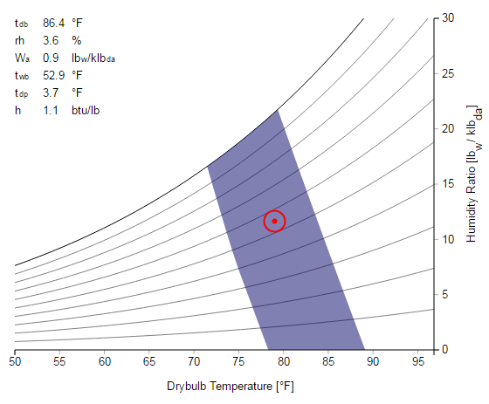
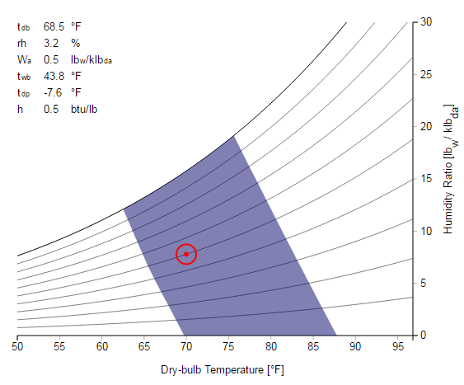
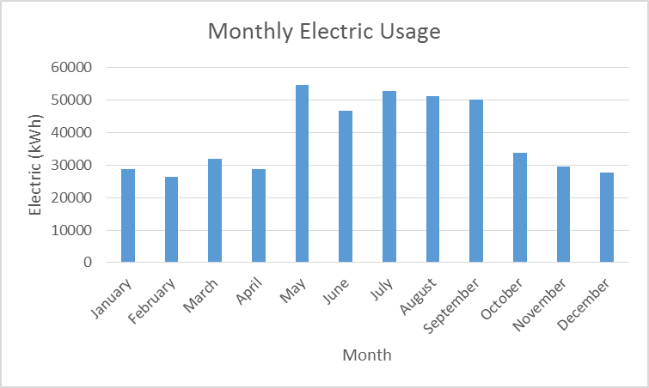
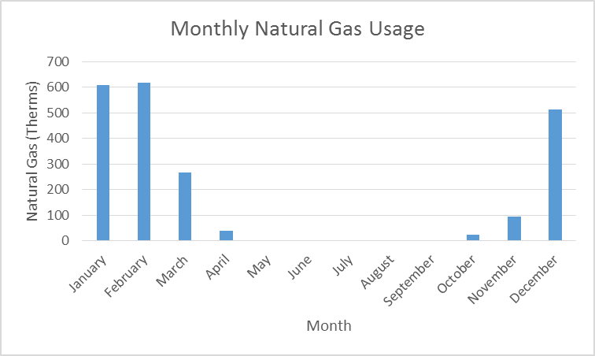
PHOENIXVILLE EARLY LEARNING CENTER
AND ELEMENTARY SCHOOL
existing energy consumption
MONTHLY UTILITY USAGE
SUMMER AND WINTER DESIGN CONDITIONS
MODELED ENERGY LOADS
charts designed with tool from cal berkley
Summer Design Conditions
Winter Design Conditions
overview
NOLAN JAMES AMOS |ae senior thesis

Slide 6
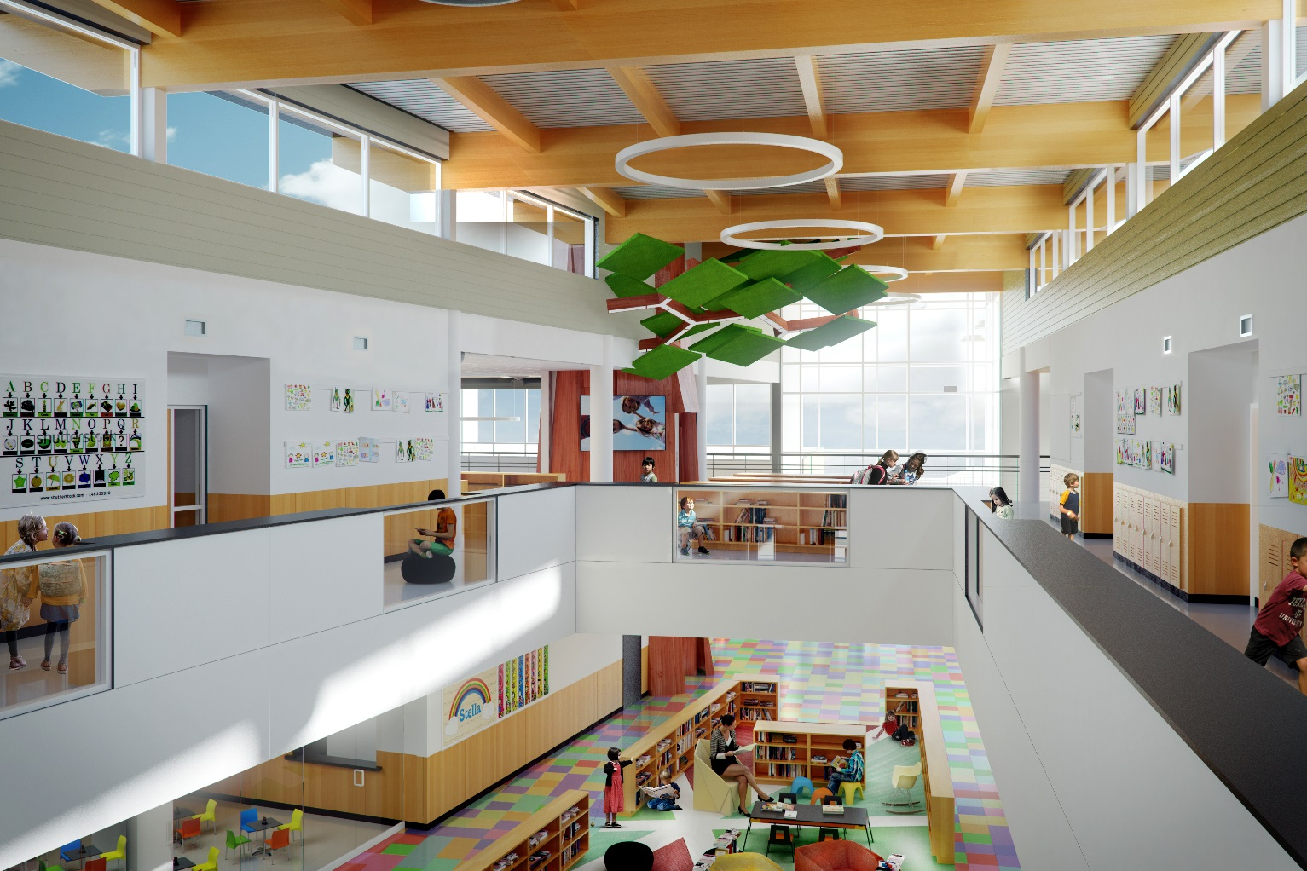
PHOENIXVILLE EARLY LEARNING CENTER
AND ELEMENTARY SCHOOL
project goals
PROJECT GOALS
ALTERNATIVES CONSIDERED
increase energy efficiency
  space utilization
ease of maintenance
lower costs
  maintenance
  upfront
  lifecycle
ground-coupled heat pump system
variable refrigerant flow system
centralized air handling unit
BASE SYSTEM
water source heat pumps
Rendering property of SHRADERgroup Architecture
mechanical depth
NOLAN JAMES AMOS |ae senior thesis

Slide 7
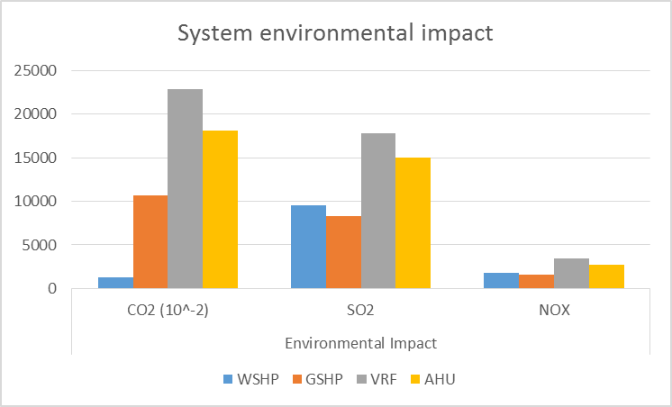
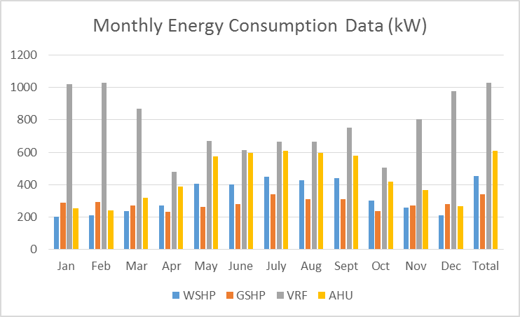
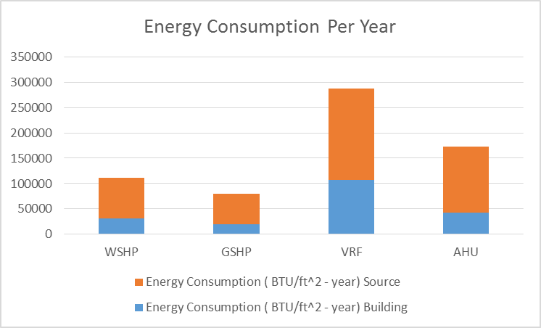
PHOENIXVILLE EARLY LEARNING CENTER
AND ELEMENTARY SCHOOL
energy analysis
ENERGY AND EMISSIONS ANALYSIS
mechanical depth
NOLAN JAMES AMOS |ae senior thesis
The loads are translated into energy consumption by source. The scope of these calculations includes district hot and/or chilled water and the total amount of makeup water required by a cooling tower—even the energy consumed by the crankcase heaters of a reciprocating compressor.
People contribute to the latent and sensible heating load. Because of the high occupancy of the building, energy loads go up in the summer months.

Slide 8
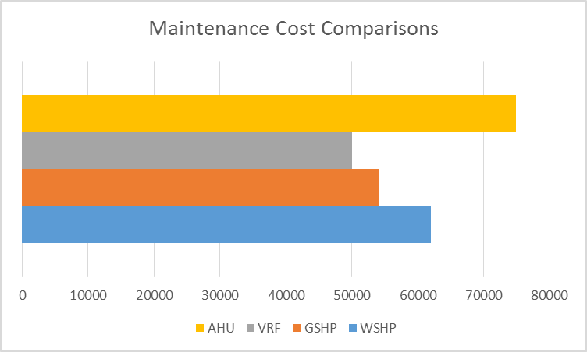
PHOENIXVILLE EARLY LEARNING CENTER
AND ELEMENTARY SCHOOL
maintenance
MAINTENANCE
mechanical depth
NOLAN JAMES AMOS |ae senior thesis
Air Filters
Condensate Drainage
Underground Pipes

Slide 9
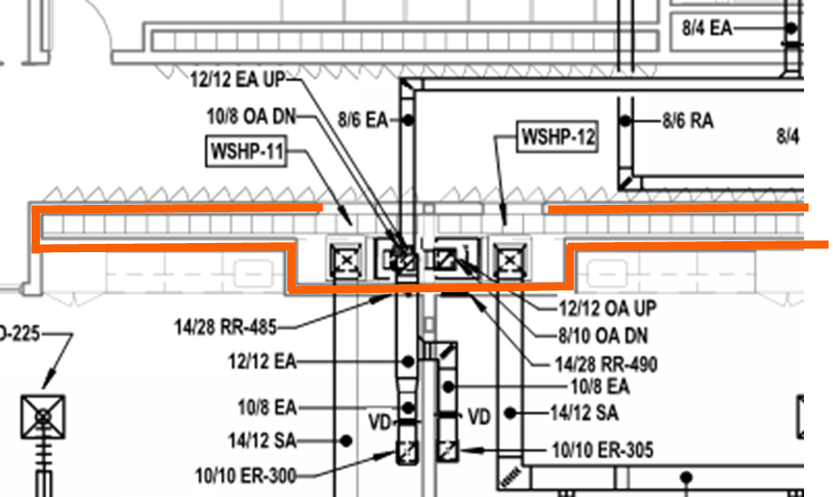
PHOENIXVILLE EARLY LEARNING CENTER
AND ELEMENTARY SCHOOL
space considerations
SPACE CONSIDERATIONS
Ground Source Heat Pumps
Closets in Corridors –
1575 sqft + ~150,000 sqft borefield
mechanical depth
NOLAN JAMES AMOS |ae senior thesis

Slide 10
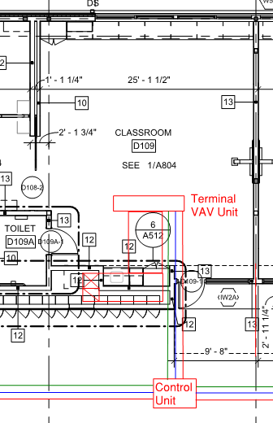
PHOENIXVILLE EARLY LEARNING CENTER
AND ELEMENTARY SCHOOL
space considerations
SPACE CONSIDERATIONS
Variable Refrigerant Flow system
Terminal Units in Classrooms
Control Units in Corridors
mechanical depth
NOLAN JAMES AMOS |ae senior thesis
Nolan Amos - Mechanical Option - Dr. William Bahnfleth, Faculty Consultant

Slide 11
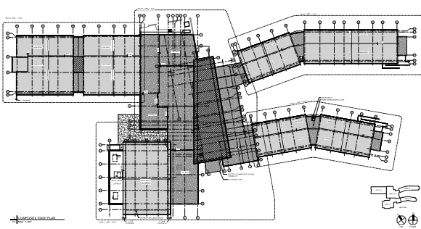
PHOENIXVILLE EARLY LEARNING CENTER
AND ELEMENTARY SCHOOL
space considerations
SPACE CONSIDERATIONS
Centralized Air Handling Unit
Multiple Units on Ceiling
= Centralized Air Handling Unit
mechanical depth
NOLAN JAMES AMOS |ae senior thesis

Slide 12
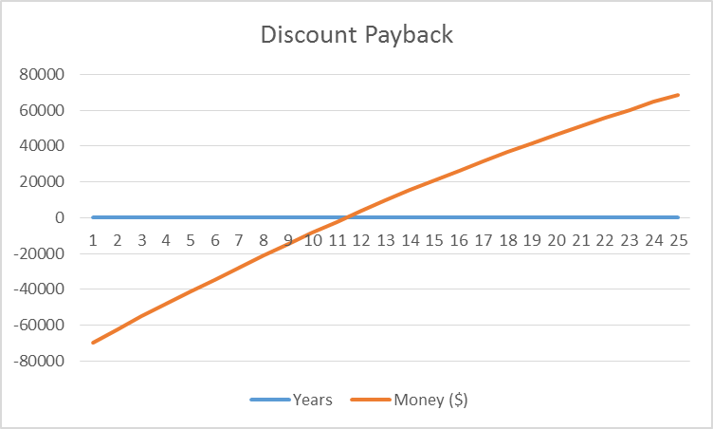
Heating balalksk
PHOENIXVILLE EARLY LEARNING CENTER
AND ELEMENTARY SCHOOL
cost analysis
Cost Analysis
VRF – Did not pay back
AHU – Did not pay back
Simple Payback = 9.34 years
Discount Payback = 11.37 years
mechanical depth
NOLAN JAMES AMOS |ae senior thesis

Slide 13
PHOENIXVILLE EARLY LEARNING CENTER
AND ELEMENTARY SCHOOL
project goals
BREADTH STUDIES
Electrical Breadth – Electrical Load
Results: VRF System used Less Power
Construction Breadth – Scheduling and cost impacts of geothermal system
breadth
NOLAN JAMES AMOS |ae senior thesis

Slide 14

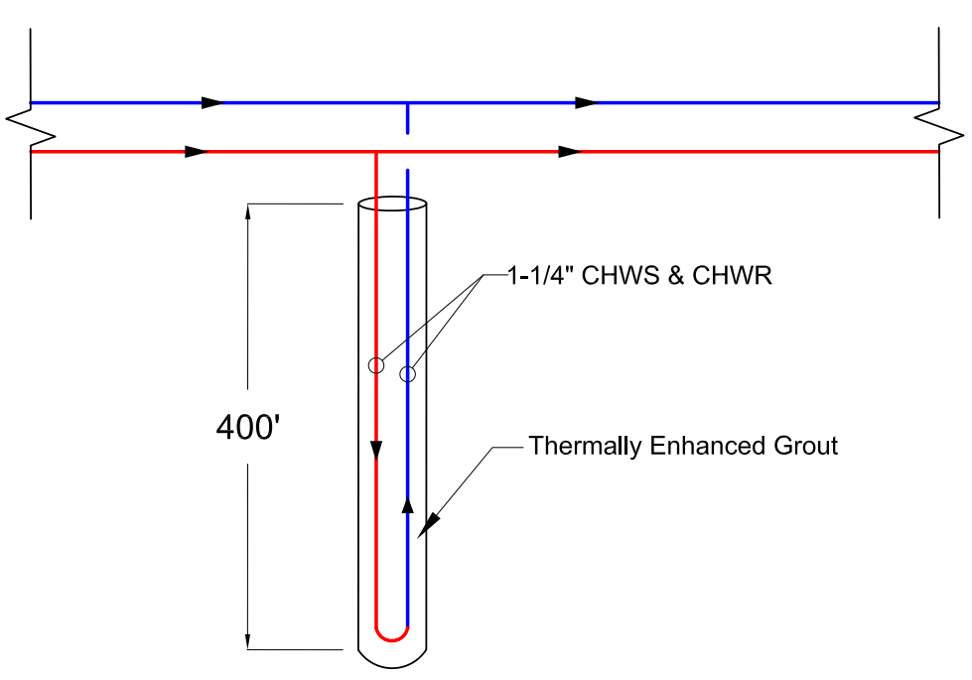
PHOENIXVILLE EARLY LEARNING CENTER
AND ELEMENTARY SCHOOL
bore field design
GEOTHERMAL BORE FIELD
Total Head Loss through well field: 363 feet
Rendering property of SHRADERgroup Architecture
breadth
NOLAN JAMES AMOS |ae senior thesis

Slide 15
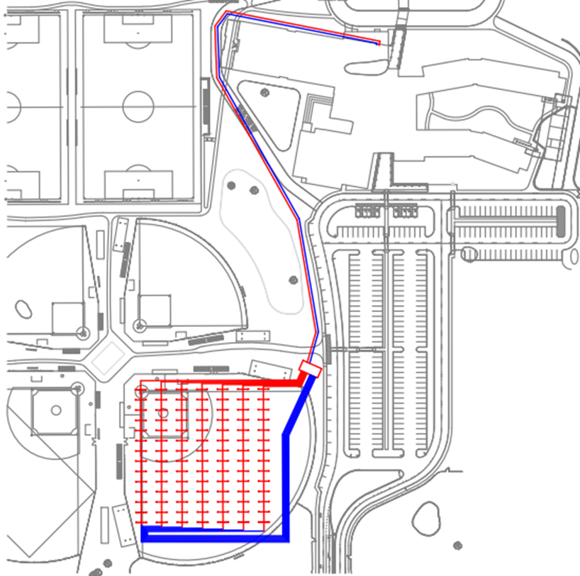
PHOENIXVILLE EARLY LEARNING CENTER
AND ELEMENTARY SCHOOL
bore field design
GEOTHERMAL BORE FIELD
WELL FIELD LAYOUT
breadth
NOLAN JAMES AMOS |ae senior thesis

Slide 16
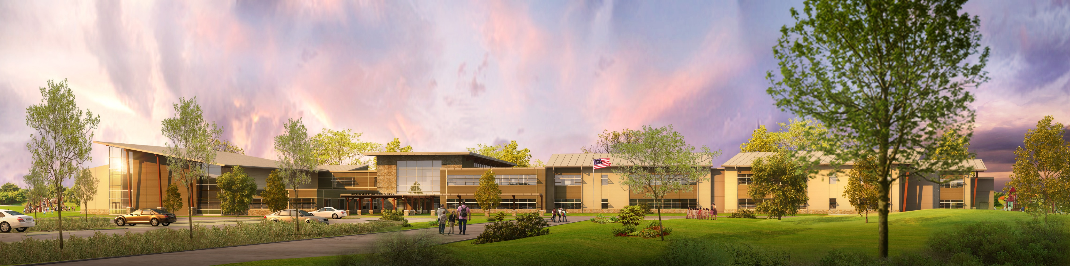
PHOENIXVILLE EARLY LEARNING CENTER
AND ELEMENTARY SCHOOL
CONCLUSIONS
Energy Emissions: GSHP
Space Utilization: VRF
Maintenance: GSHP/WSHP
Cost: GSHP
Rendering property of SHRADERgroup Architecture
conclusions
NOLAN JAMES AMOS |ae senior thesis

Slide 17
PHOENIXVILLE EARLY LEARNING CENTER
AND ELEMENTARY SCHOOL
AKNOWLEDGEMENTS
Dr. Bahnfelth
Barton Associates
SCHRADERgroup Architecture
Phoenixville School District
AE Class of 2016
My Parents
Rendering property of SHRADERgroup Architecture
conclusions
NOLAN JAMES AMOS |ae senior thesis
Questions?

Slide 18
PHOENIXVILLE EARLY LEARNING CENTER
AND ELEMENTARY SCHOOL
Questions?
Rendering property of SHRADERgroup Architecture
conclusions
NOLAN JAMES AMOS |ae senior thesis

Slide 19
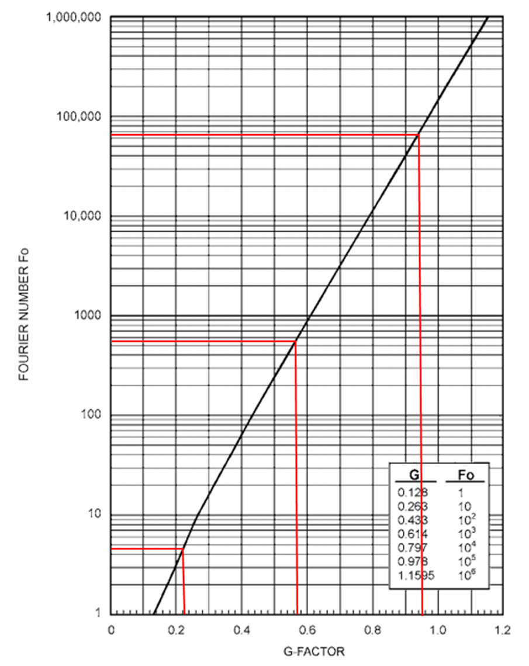
PHOENIXVILLE EARLY LEARNING CENTER
AND ELEMENTARY SCHOOL
Bore hole calculations
Appendix
NOLAN JAMES AMOS |ae senior thesis
appendix
1.
2.
3.

Slide 20
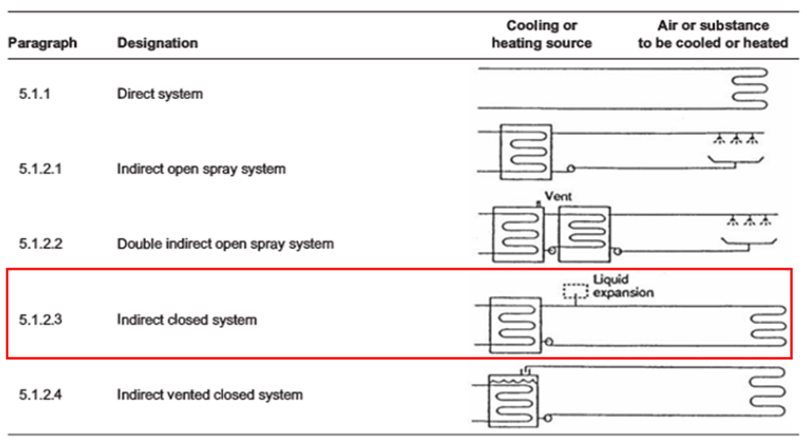
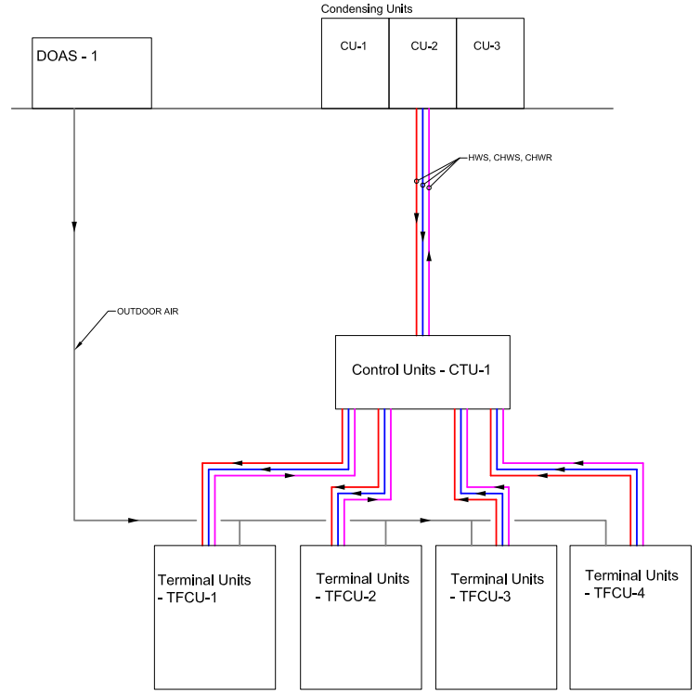
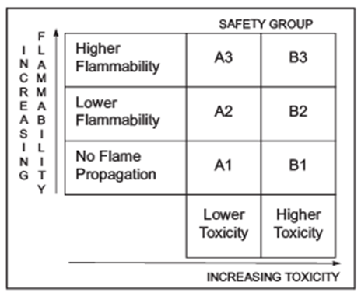

PHOENIXVILLE EARLY LEARNING CENTER
AND ELEMENTARY SCHOOL
vrf analysis
Appendix
NOLAN JAMES AMOS |ae senior thesis
appendix

